Slide 1

FLIGHT DELAY ANALYSIS
PROJECT NAME

Slide 2

GROUP MEMBERS
POLISETTI SAI RAGHU RAM
ANKUR KUMAR
PARIKSHIT NARAYANRAO THAKARE
AKANKSHA SUNIL MAHAJAN
YUKTA ARVIND BHAI PATEL
GAURAV GAJANAN TALELE
AVDHUT AVINASH LONE

Slide 3
INTRODUCTION
✈️ About FLIGHT DELAY ANALYSIS:
Flight delays are a major concern in the aviation industry, affecting passenger satisfaction and operational efficiency. This analysis focuses on understanding the key factors behind delays by examining historical flight data. By identifying trends and causes—such as weather, airline performance, and airport congestion the study aims to provide insights that can help improve airline operations and reduce delays.
Project Objective :
The objective of this analysis is to identify the main causes of flight delays, analyze historical data to uncover patterns, and provide insights to help reduce delays and improve airline efficiency through data-driven decisions.

Slide 4
DATASET OVEREVIEW
1.Dataset Size and Source:
Contains:10 Lakh+ rows of airline operational data.
Source: Flight Data Analysis Record.
2.Flight Details: Carrier Name, Flight Number, Route, Distance, Departure
& Arrival Times, IATA Code, Airport Details, Country, Lattitude, Longitude
3. Date Information: Year, Month, Day.
4. Data Cleaning & Optimization:
Error Handling: Replaced invalid Load Factor values with 0% after removing null values and Duplicates.
SQL Optimization: Used indexing to improve query performance.

Slide 5
Tools Used & Key Insights
Tools Used :
We have used four powerful tools to analyze airline operations:
Excel – Cleaning and organizing data for initial analysis.
SQL – Extracting useful insights from large databases.
Power BI & Tableau – Interactive dashboards and data visualization.
Key Insights
Weekday vs. Weekend Travel – Analise passenger flow patterns.
Busiest Flight Routes – Identified the most travelled routes.
Seasonal Trends – Found peak and off-peak travel periods.

Slide 6
Kpi 1(Weekday Vs Weekend total flights statistics)
Observation:
WN (Southwest Airlines) dominates with 21.25% of total weekday flights.
Airlines like VX, HA, F9 have consistently low flight shares around 1% or lower across both weekdays and weekends.
The percentage share for each airline does not drastically change between weekdays and weekends.
AA and EV operate slightly more on weekdays.
Inference:
Southwest Airlines (WN) is the most active airline across both weekdays and weekends, indicating strong frequency and consistent scheduling.
Delta (DL) and American Airlines (AA) maintain significant presence across the week, reflecting their major network and demand.
Operational focus of certain smaller airlines remains low and stable, possibly serving regional markets.
The flight volume pattern is relatively consistent between weekdays and weekends, suggesting airlines maintain similar capacity irrespective of the day of the week.

Slide 7
Kpi 2 (Total number of cancelled flights for JetBlue Airways on first date of every month)
Observation:
In January, 0 cancellations on 1st day of month.
In February, a sharp spikes to 42 cancellations on the 1st day highest among all 3 months.
In March, cancellation drops to 13,a significant decrease from February.
Inference:
February 1st experienced an unusually high number of JetBlue flight cancellations, possibly due to:
- Severe weather (e.g., winter storms).
- Operational or scheduling disruptions.
- System or crew availability issues post-January.
The drop in March suggest the February in isolated incident, not a consistent trend.
Zero cancellation in January indicates Jet blue typically maintaining strong operational control, expect for exceptional conditions.

Slide 8
Kpi 3 (Week wise, State wise and City wise statistics of delay of flights with airline details)
Observation:
Southwest Airlines has the highest count of departure delays (215,857).
- Delta Air Lines follows with 105,184 delays.
- Airlines like Frontier, Hawaiian, and Virgin America report the lowest delay counts (~14,000).
The same pattern is seen in arrival delays:
- Southwest Airlines again leads with 215,453 delays.
- Followed by Delta Air Lines (~104,794).
- Smaller carriers again show the lowest delays (~14,000).
Inference:
Southwest Airline consistently experiences highest delays in both departure and arrival, likely due to its large operational volume and frequent scheduling.
Delta and American also have significant delay volumes as major carriers.
Smaller airlines like Hawaiian, Virgin America, and Frontier report far fewer delays.

Slide 9
Kpi 4 (Number of airlines with No departure/arrival delay with distance covered between 2500 and 3000)
Observation:
United Air Lines Inc. leads with 72 flights in the 2500–3000 km range without any delay.
Delta Air Lines, JetBlue, and Alaska Airlines each operate 50+ delay-free flights in this distance bracket.
Airlines such as Virgin America (34), US Airways (27), and Hawaiian Airlines (17) have lower numbers of delay-free long-distance flights.
Bubble size reinforces the count visually—larger bubbles = more delay-free flights.
Inference:
United Airlines demonstrates strong operational efficiency on long-distance routes (2500–3000 miles), leading in punctuality for this range.
Major airlines like Delta, JetBlue, and Alaska also show good performance with a high number of long-haul flights arriving on time.
Airlines with fewer such flights (e.g., Hawaiian, US Airways) may:
- Operate fewer long-distance routes.
- Face more route-specific challenges impacting punctuality.
This chart helps highlight airlines best suited for long-distance, on-time travel—a key insight for both customers and airline performance analysts.

Slide 10
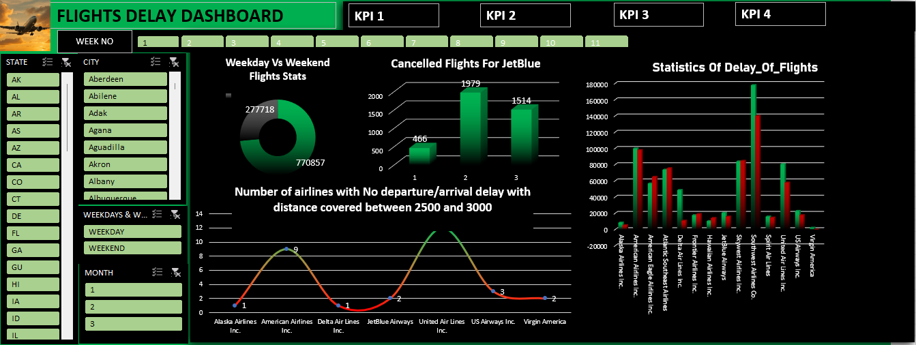
EXCEL DASHBOARD OVERVIEW

Slide 11
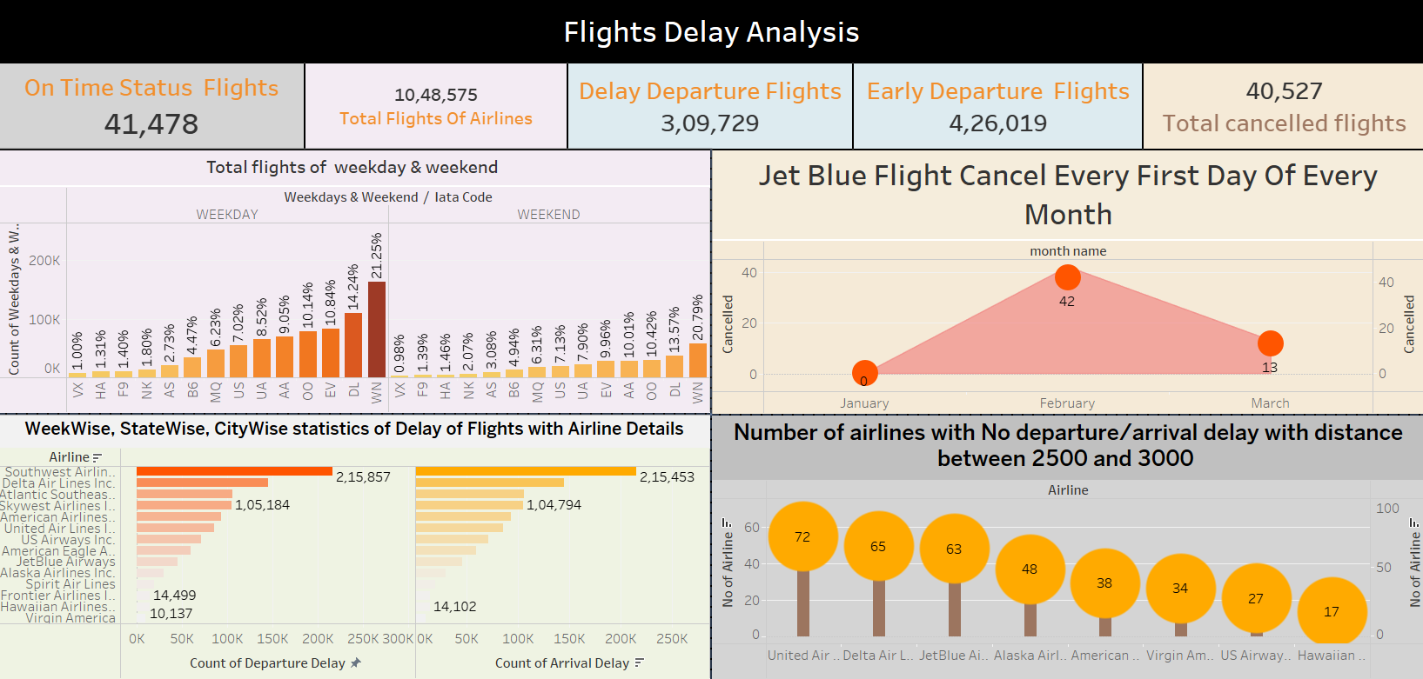
TABLEAU DASHBOARD OVERVIEW

Slide 12
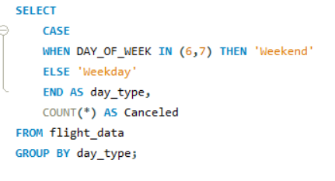
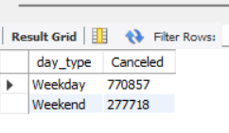


SQL QUERIES
KPI 1
KPI 2

Slide 13
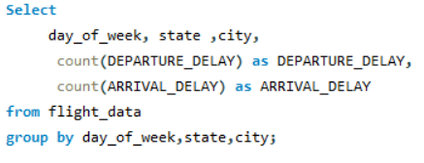
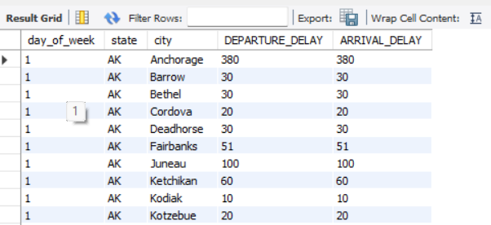
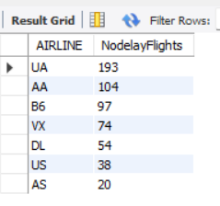
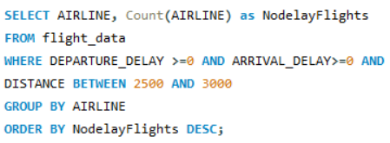
SQL QUERIES
KPI 3
KPI 4

Slide 14
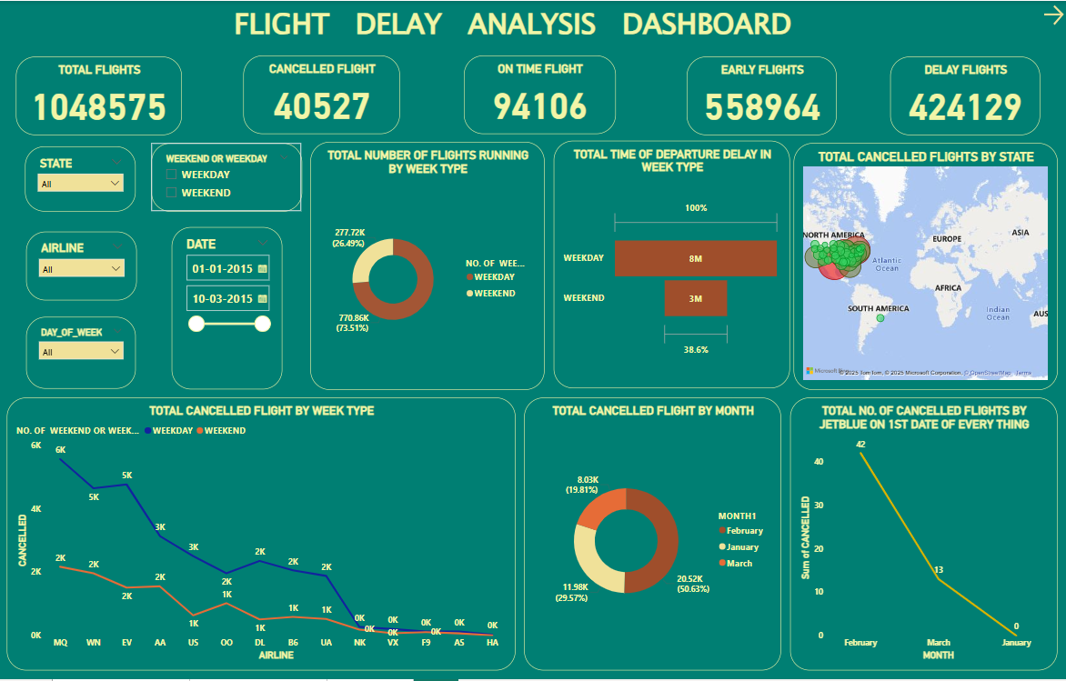
POWER BI DASHBOARD OVERVIEW

Slide 15
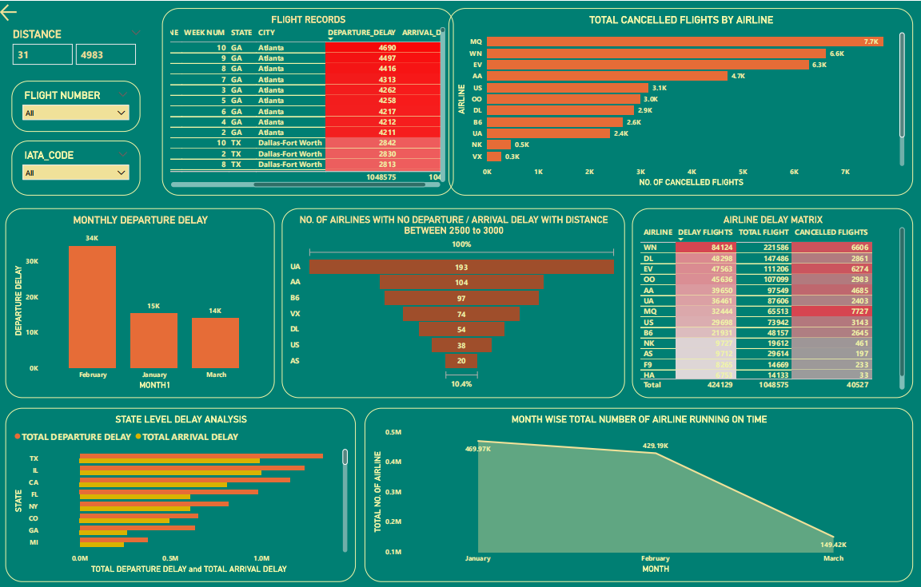

Slide 16
Challenges
Data Cleaning : Solved using Excel and SQL to clean records and standardize values.
Understanding KPI Requirements : Team collaboration and reviewing real examples helped clarify metrics.
Understood Data modelling in more Elaborative way
I also Got to know that How I can use DAX formulae in Excel if possible, to retrieve date (min and max )
Visualizing Data Clearly : Used charts, graphs, and color-coded analysis in PowerPoint.
Time Management : Planned deadlines and tracked via shared documents.
Handling Missing Data : Used data imputation methods and filtered out outliers to maintain quality.
While Importing data Most Of Rows are Not getting Imported
While Adjusting Tableau charts.
We Also Got to Know that Creating Buckets is a new concept for me here and What is most important AS Analyst

Slide 17
Recommendations
Improve Operational Efficiency in High Delay Airlines
Enhance Focus on On-Time Performance.
Investigate JetBlue Monthly Cancellation Spikes.
Optimize Weekday vs Weekend Operations.
Focus on Long-Haul Flight Efficiency.
Reduce Flight Cancellations with Predictive Planning
Regional/City-Wise Delay Mapping

Slide 18
CONCLUSION
Throughout this project, we effectively utilized multiple data analytics tools to clean, process, analyze, and visualize data.
Excel helped in data cleaning and basic analysis.
SQL enabled efficient data extraction and querying.
Power BI and Tableau provided interactive dashboards and advanced visualizations for better decision-making.
By integrating these tools, we streamlined the data analysis process, ensuring accuracy, efficiency, and impactful decision-making. This approach showcases the power of combining different technologies for a comprehensive data-driven strategy.

Slide 19

THANK YOU
We are grateful to our mentor,
Ms. DIPTI SINHA

